Slide 1
Basics of Electronics Engineering
(EC22001)
LED

Slide 2
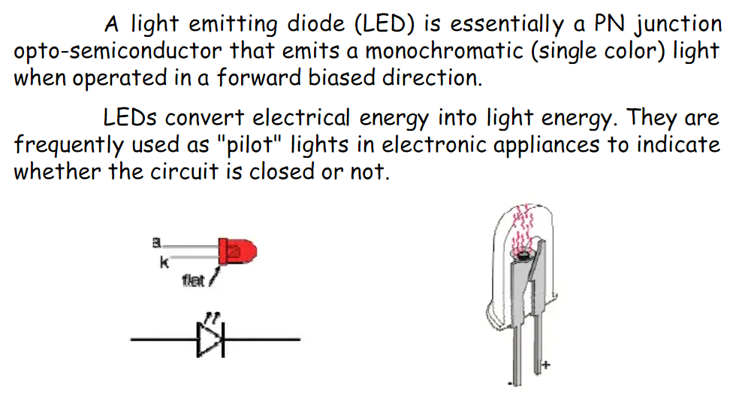
Light Emitting Diode

Slide 3
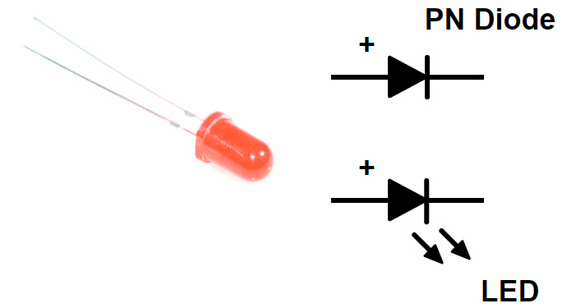
Light Emitting Diode
LED is a semiconductor light source.
It consists of a PN Junction Diode.
When voltage is applied to the LED, electrons and holes recombine in the PN Junction and release energy in the form of light (Photons).
The light emitted by an LED is usually monochromatic i.e. of single color and the color is dependent on the energy band gap of the semiconductor.
Light Emitting Diodes can be manufactured to emit all the wavelengths of visible spectrum i.e. from Red (620 nm to 750 nm) to blue – violet (380 nm to 490 nm).

Slide 4

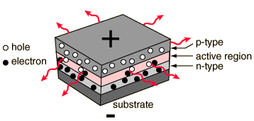
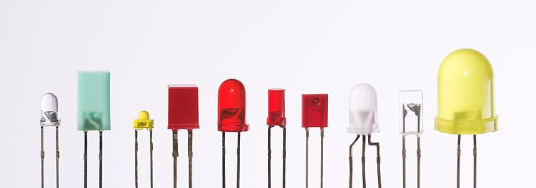
LIGHT EMITTING DIODE
Structure
LED Symbol
LED Structure
CHARGE CARRIER RECOMBINATION
EMITTING LIGHT
DIFFUSED P-TYPE
EPITAXIAL N-TYPE
V_{s}
GOLD FILM CATHODE
CONNECTION
Schematic View of LED Structure

Slide 5
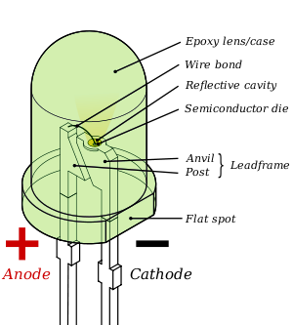
LIGHT EMITTING DIODE
Anatomy
Anatomy of an LED

Slide 6
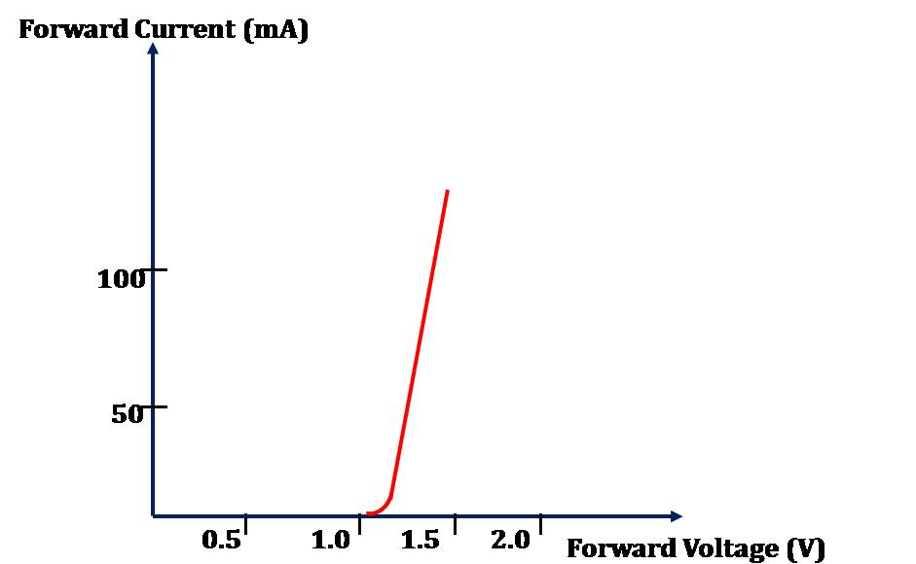
LIGHT EMITTING DIODE
Characteristics
Forward Bias VI Curve

Slide 7
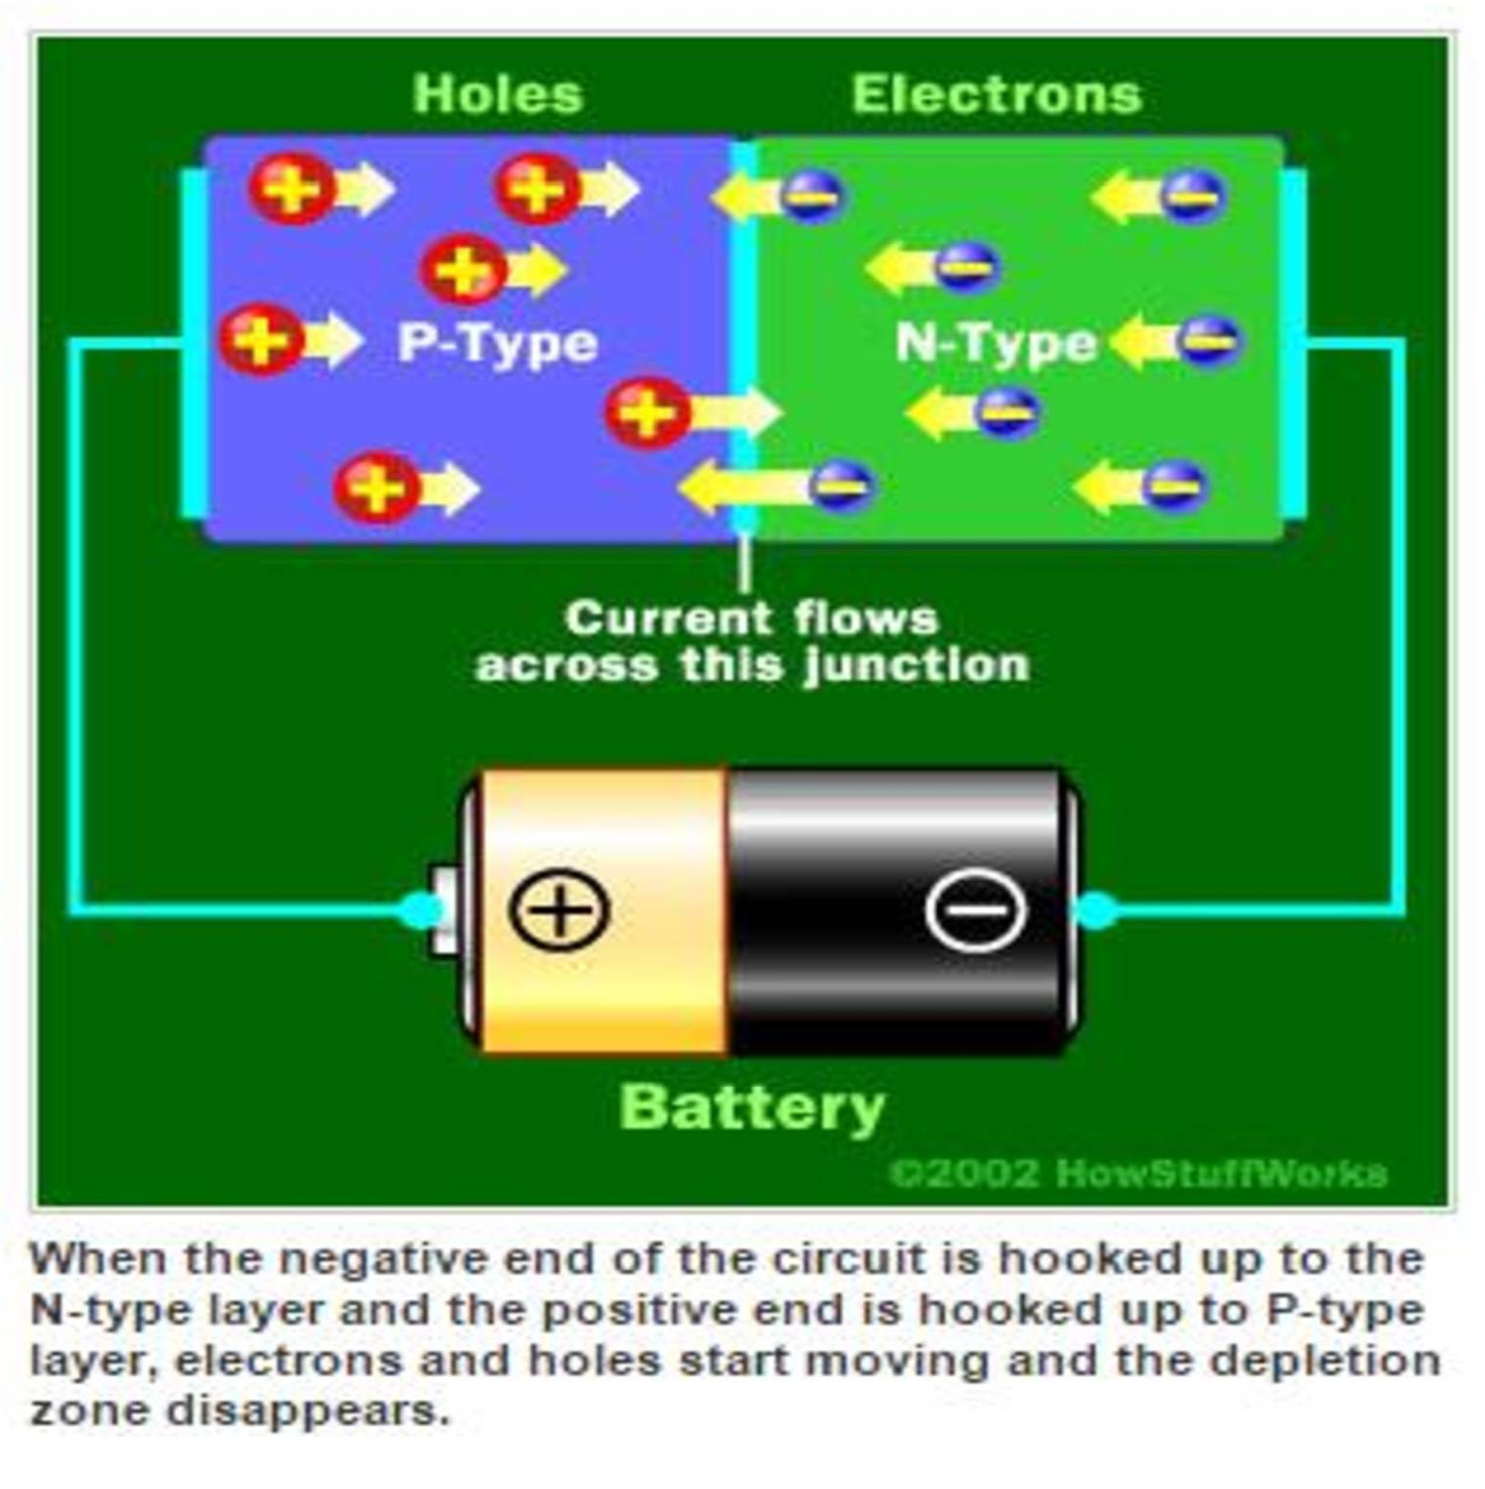

Slide 8
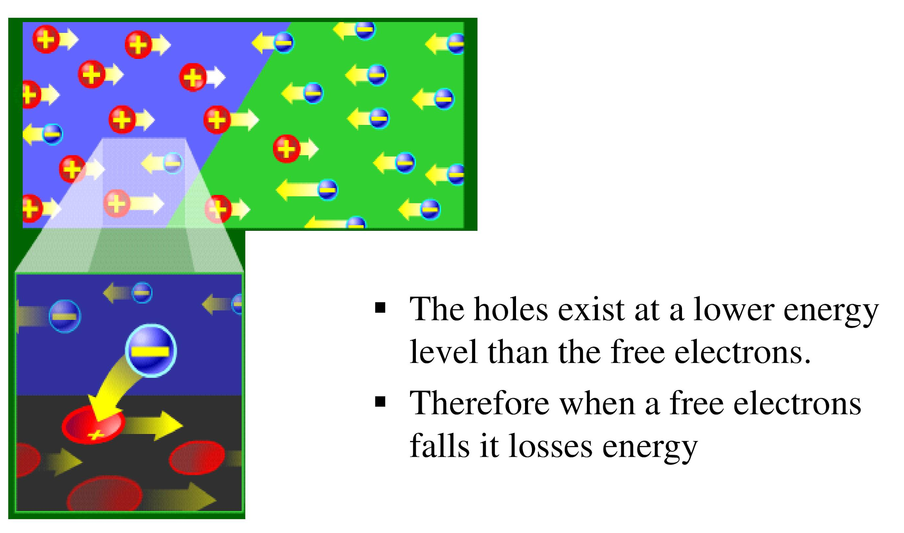

Slide 9
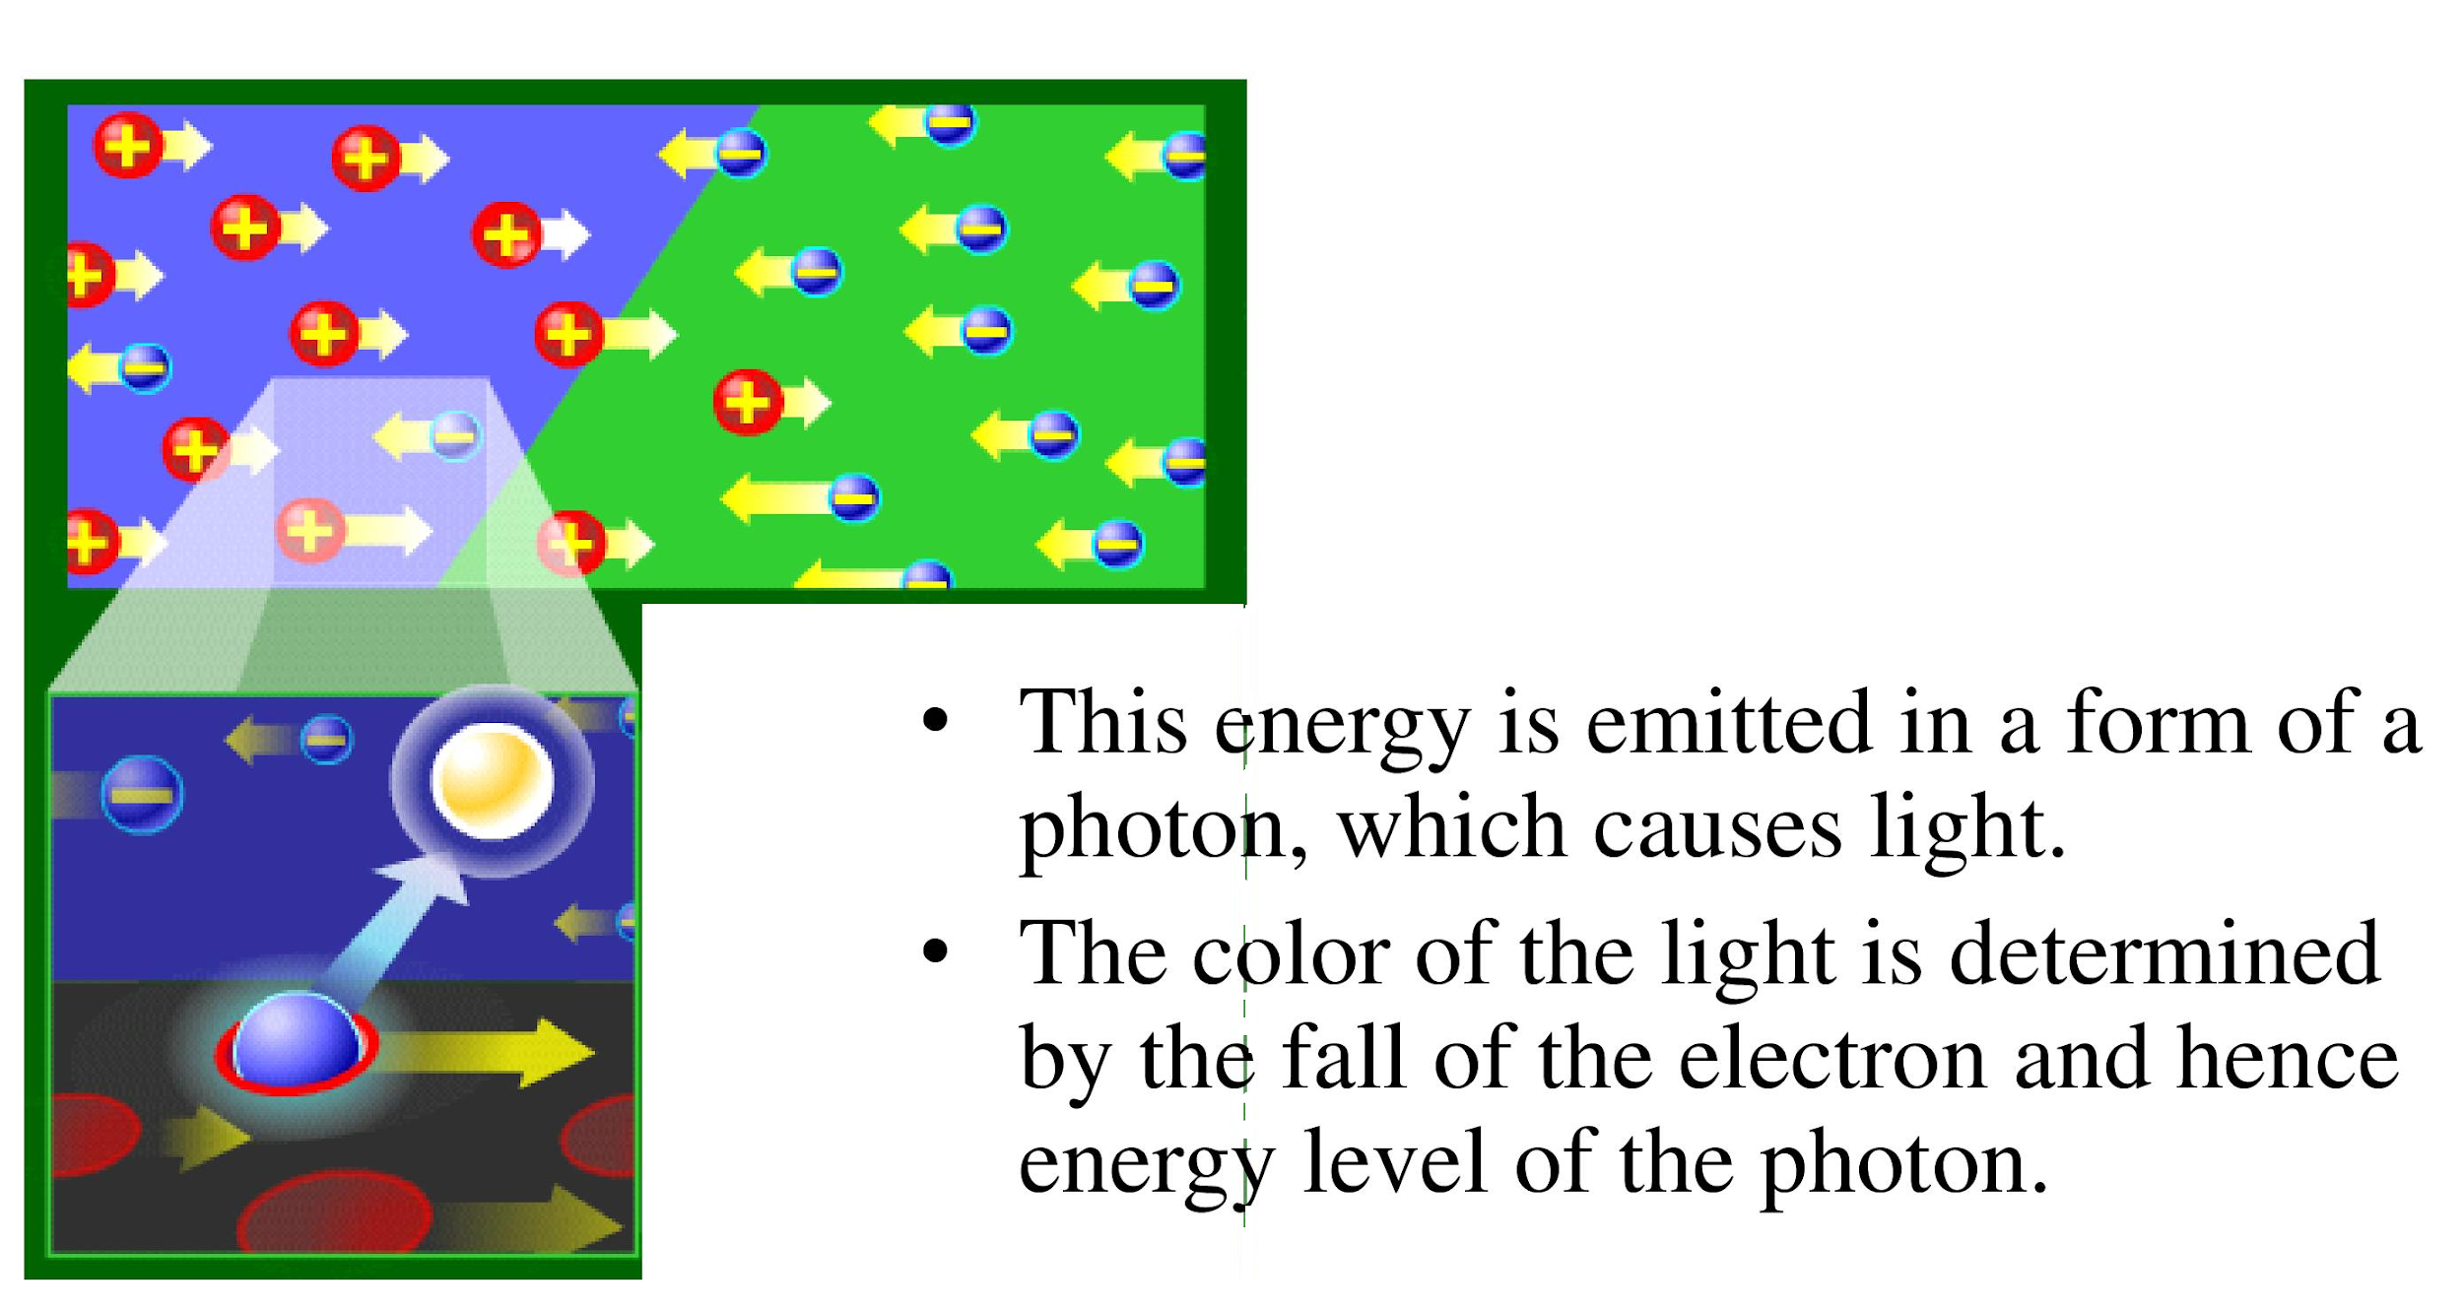

Slide 10
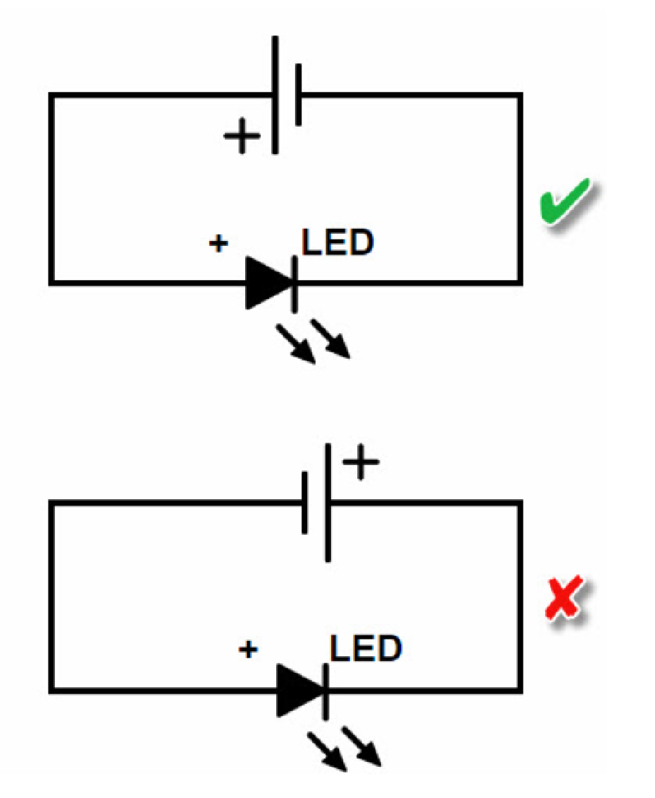

Slide 11
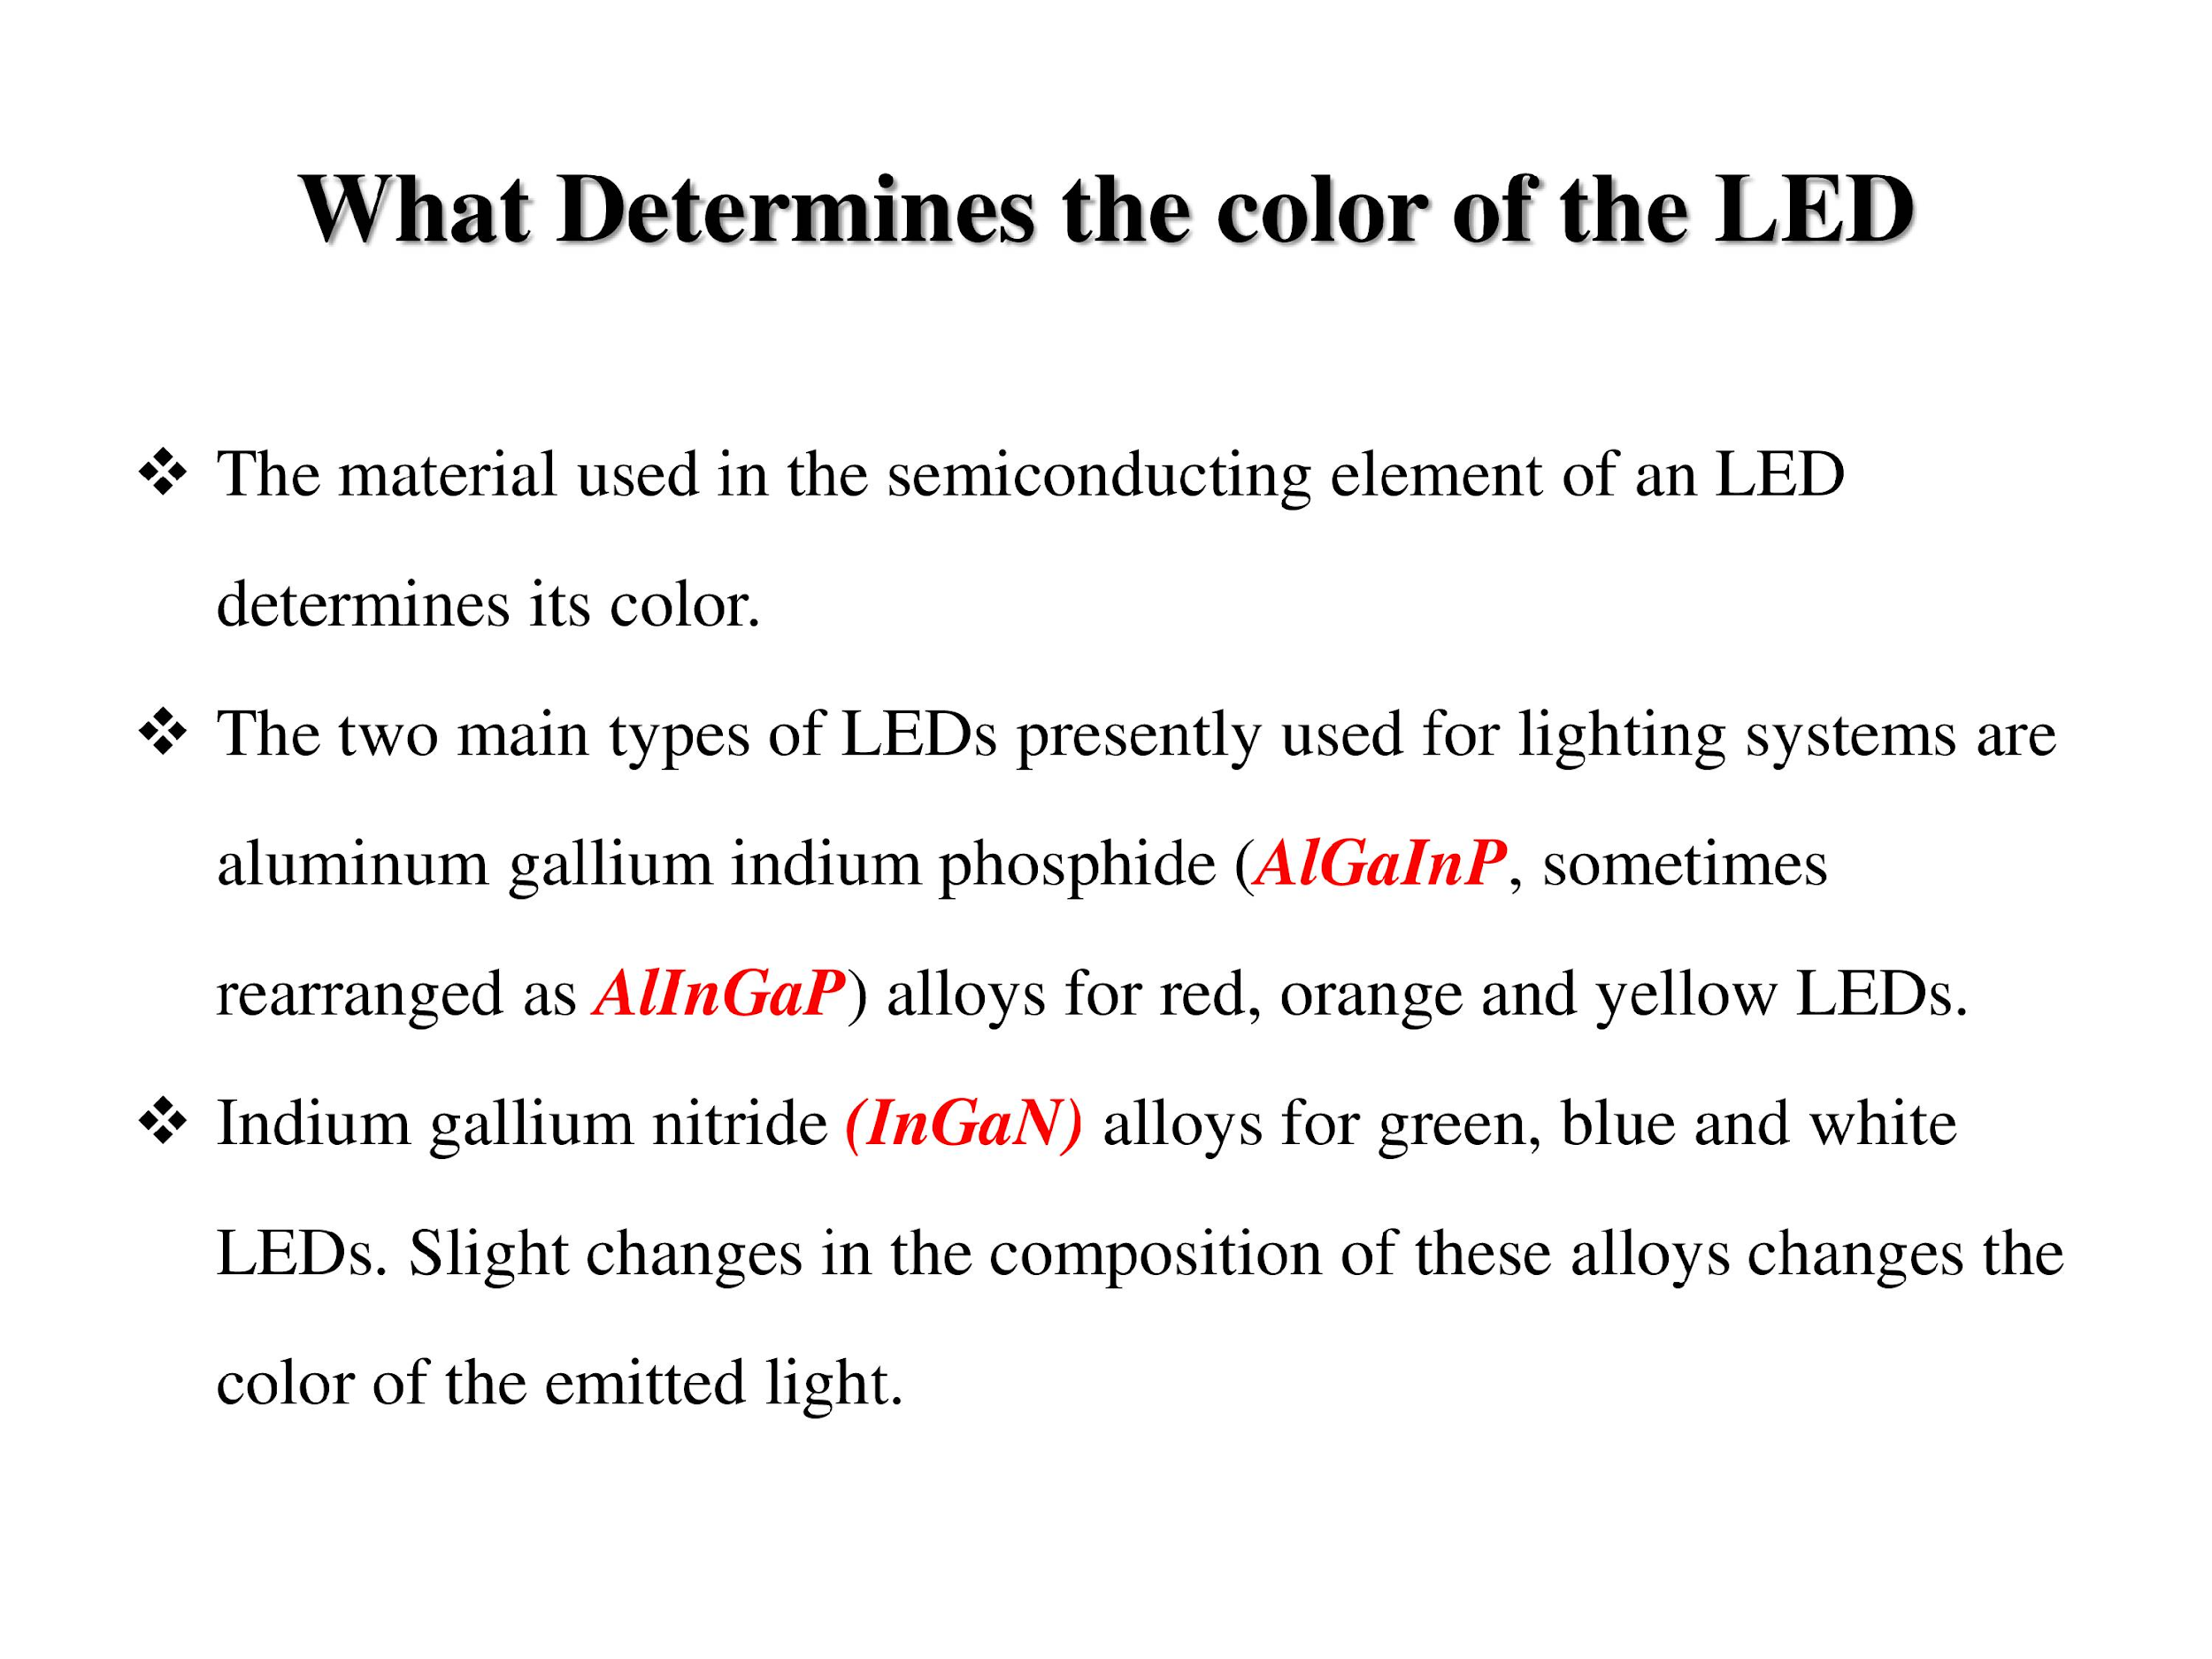

Slide 12
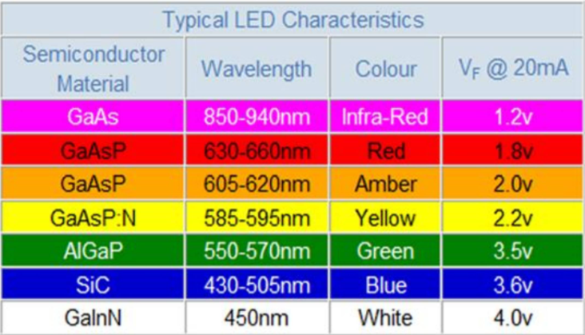

Slide 13
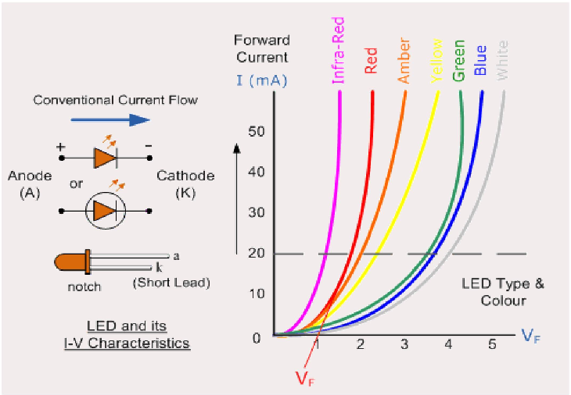

Slide 14
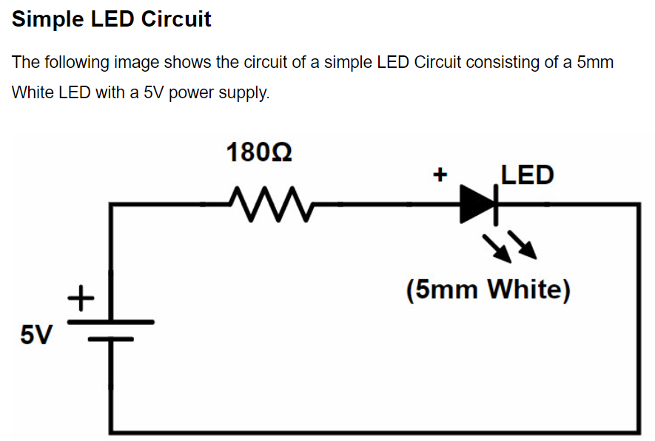

Slide 15
Applications
Light Emitting Diodes are almost everywhere. You can find LEDs in Cars, Bikes, Street Lights, Home Lighting, Office Lighting, Mobile Phones, Televisions and many more.
The reason for such wide range of implementation of LEDs is its advantages over traditional incandescent bulbs and the recent compact fluorescent lamps (CFL).

Slide 16
Few advantages of LEDs over incandescent and CFL light sources are mentioned below:
Low Power Consumption
Small Size
Fast Switching
Physically Robust
Long Lasting

Slide 17
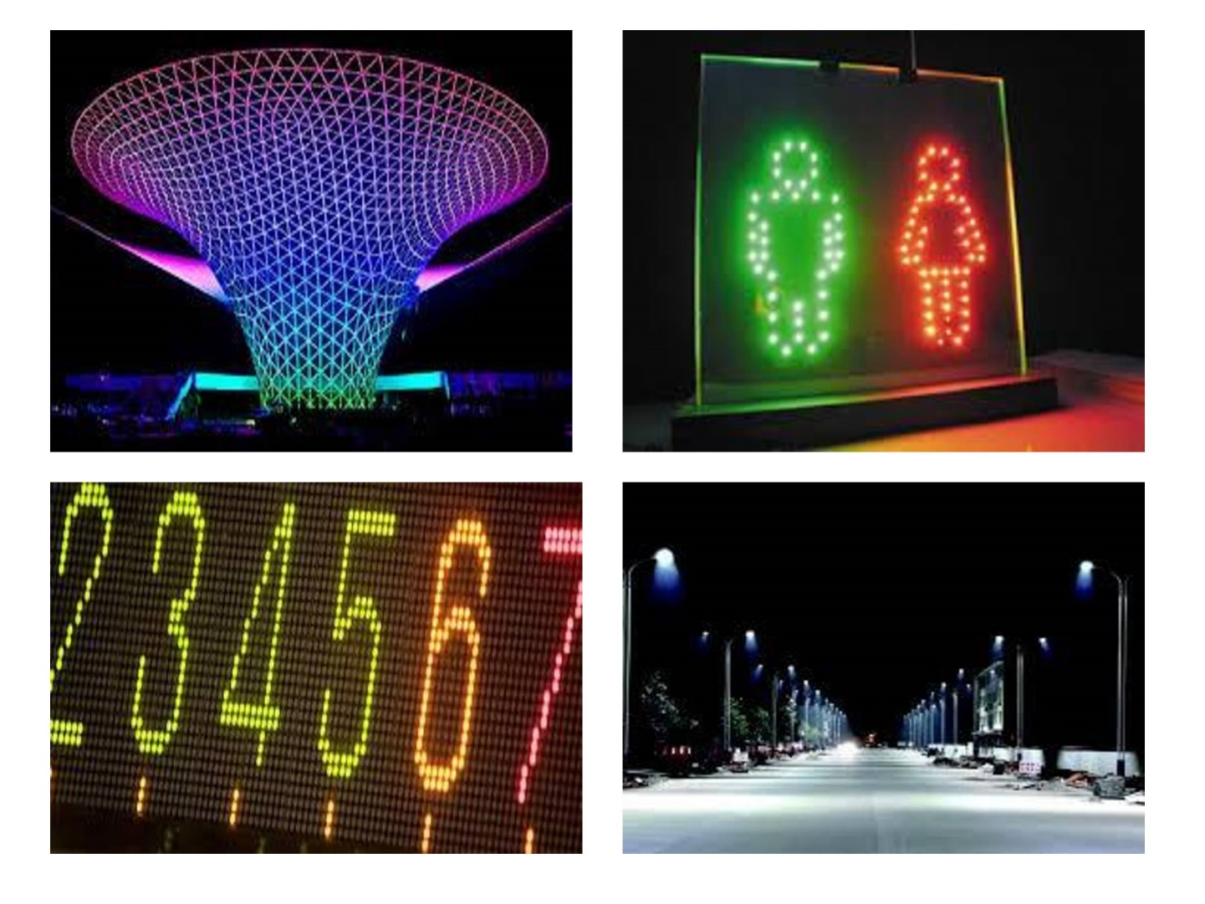

Slide 18


Slide 19
Useful Links
https://www.electronicshub.org/led-light-emitting-diode/
https://drive.google.com/file/d/1dX0utp8ciLXg02YtWGaWmdRK_-WCy33o/view?usp=sharing
https://drive.google.com/file/d/1d_QVji4NLE4Ebi1_6wh9NEzhCTOViQS3/view?usp=sharing

Slide 20
Thank You

